Slide 1

ANALYSIS ON PRICES OF USED CARS

Slide 2
About me
Pavani Munagala
I Completed my graduation in Biotechnology Engineering from National Institute of Technology Raipur in 2024, where I worked on a exciting project named “Detection of Cancer Cells Using Linear Regression Models”. That was a turning point for me, as it sparked a deep interest in the field of data driven research and AI.
As I delved deeper into this project, I became fascinated by how machine learning could be applied to solve real -world biological problems. It was through this exposure that I realized my passion for Data Science a field that is not only booming today but also shaping the future across many industries.Motivated by this interest, I decided to pursue my career in Data Science.
Linkedin:www.linkedin.com/pavani-munagala
Github::https://github.com/Pavani-Reddy111
Saideepu Balaraju
I completed B.Tech in Computer Science Engineering from JNTUA 2025.
During my final year, I worked on a project titled “Credit Card Fraud Detection using Predictive Modelling”, which sparked my deep interest in the field of Data Science. Motivated by this interest, I began exploring real-world datasets, tools, and techniques used in data-driven decision-making. I am now eager to pursue a career in Data Science, where I can combine my technical skills and analytical mindset to solve meaningful problems.
Linkedin:linkedin.com/in/saideepu-balaraju
Github:https://github.com/SAIDEEPUBALARAJU-2003

Slide 3
Agenda
Objective of the project
Web Scraping
Information about Collected Data
Exploratory Data Analysis:
Data Cleaning Steps
Data Manipulation Steps
Data Visualization
Analysis based on Features
Obsercations
Conclusion

Slide 4
Objective Of Our Project
Main goal of the project is to analyze historical car sales data to understand the features that impacts the price of a car.
Importance of this analysis:
This helps buyers who lacks technical knowledge about car depreciation, brand impact and market trends.
This helps sellers to set competitive prices without undercutting their profits and also overestimating the price of car.
This analysis helps buyers to find appropriate cars under budget.

Slide 5
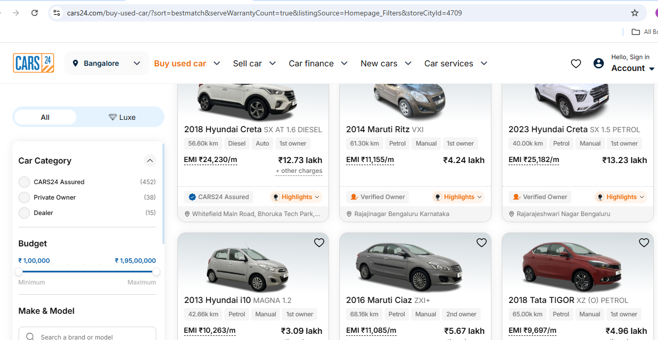
Data Collection
We collected data from Cars24 website.

Slide 6
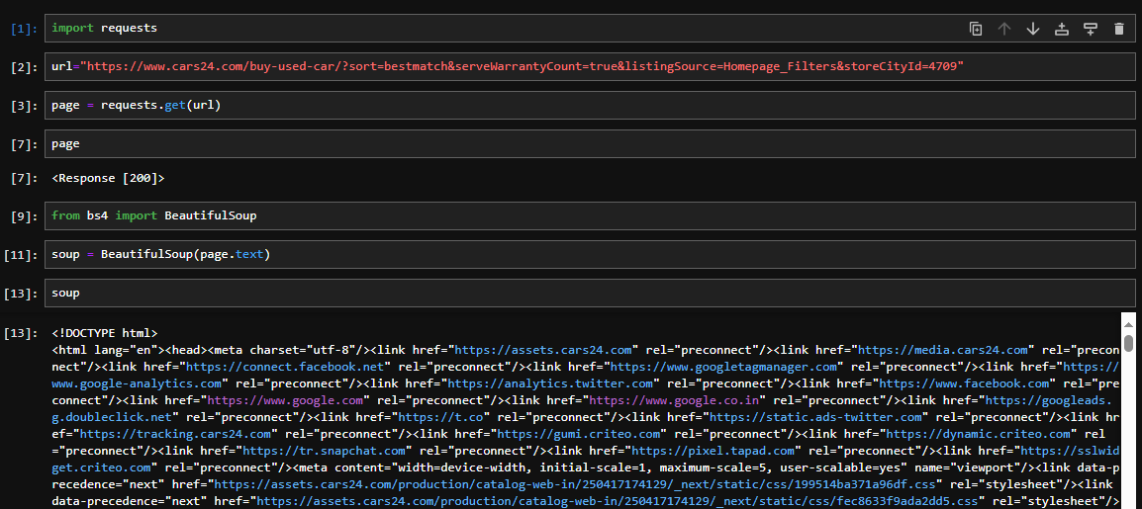
Data Collection Process
Extracted the data using Requests and Beautiful Soup call with the help of Requests

Slide 7
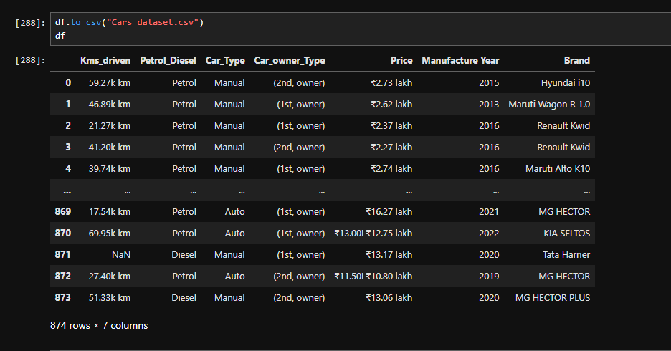
Raw Data Overview

Slide 8
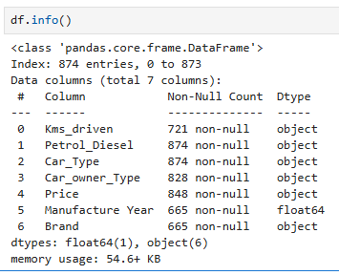
Features Extracted
.Total columns:7
.Total _rows:874
. Kms_driven,Fuel_Type,Car_type,
Car_owner_type,Price,Brand,Year
are extracted from cars24.

Slide 9
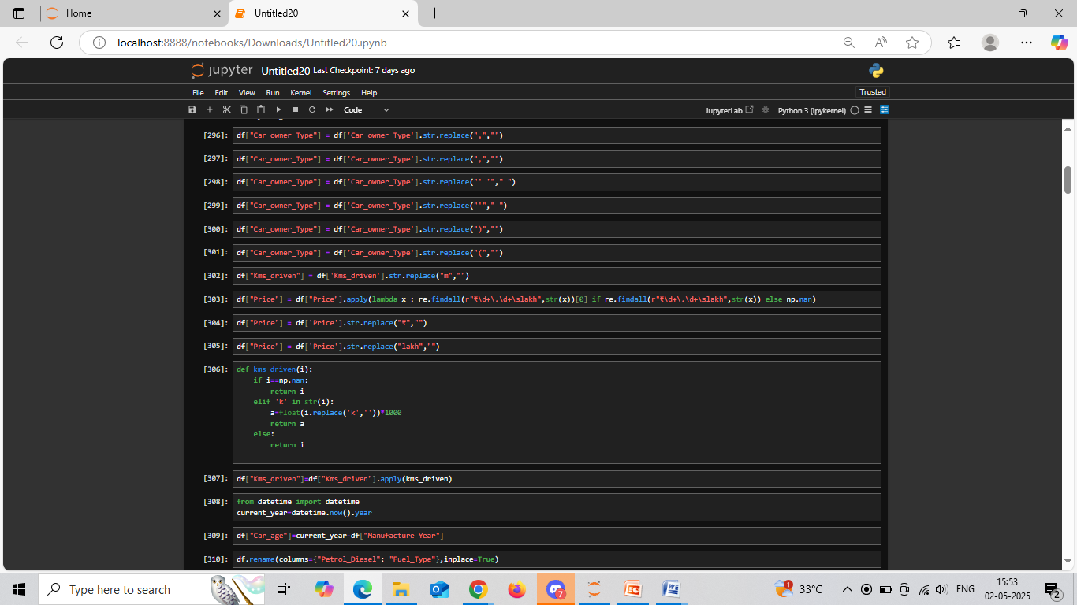
Data Cleaning
Replacing all the special Characters with space in the Car_owner_type and Kms_driven columns.

Slide 10
Data Cleaning
Replacing valid prices using regular expressions in Price column.
Converting Kms driven values to numeric by removing k and multiplying it with 1000.

Slide 11
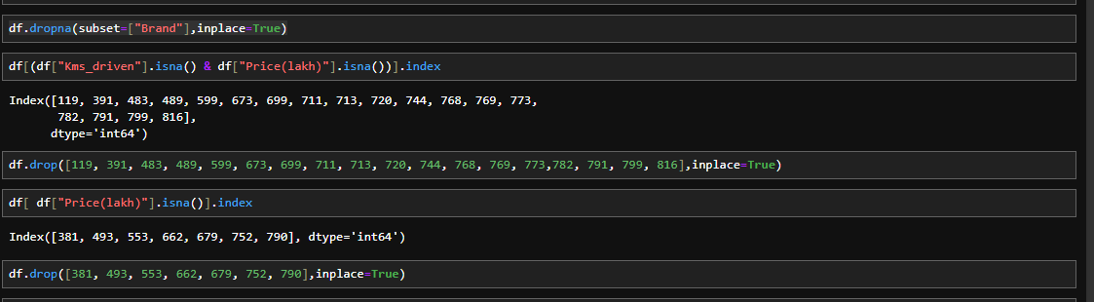
Data Cleaning:
Dropping the null values from brand column.
Dropping the null values from Kms_driven and price column.
Very few null values are present in both.

Slide 12
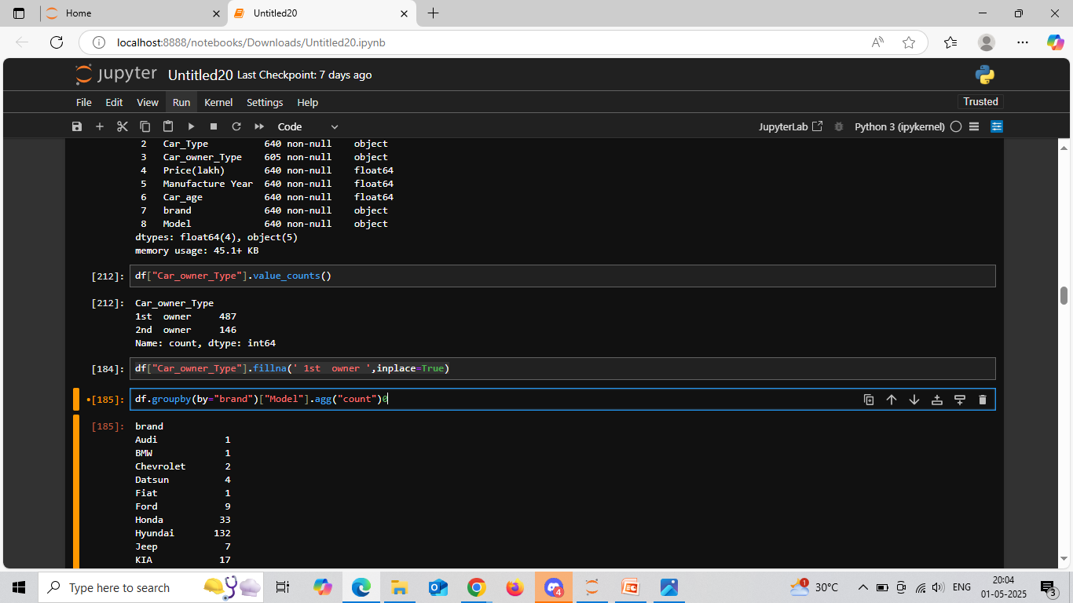
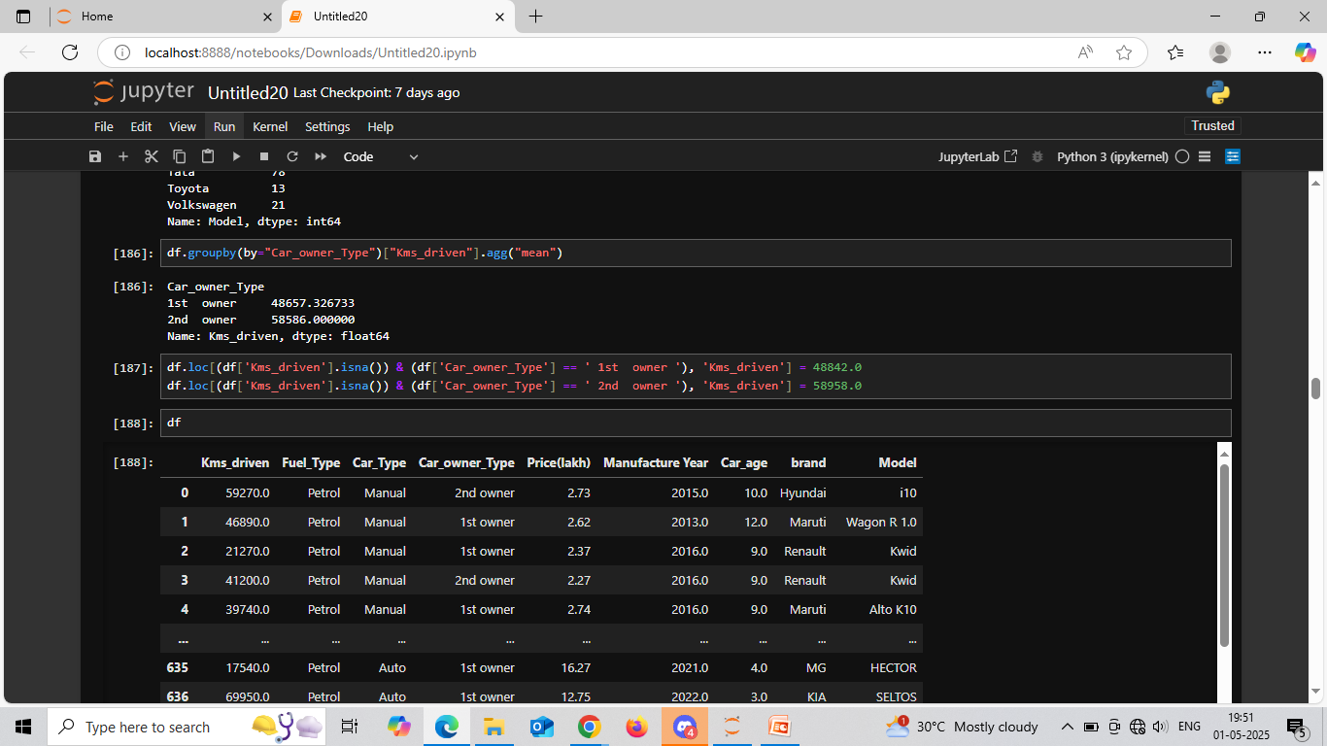
Data Cleaning
Counting the values from Car_owner_type column and filling the null values with maximun count i.e. 1st owner.
Using group by imputation on Car_owner_type and Kms_driven column with agg func mean to fill null values in kms_driven column.

Slide 13
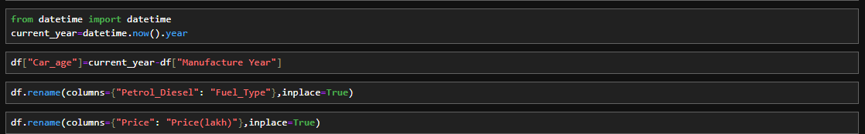
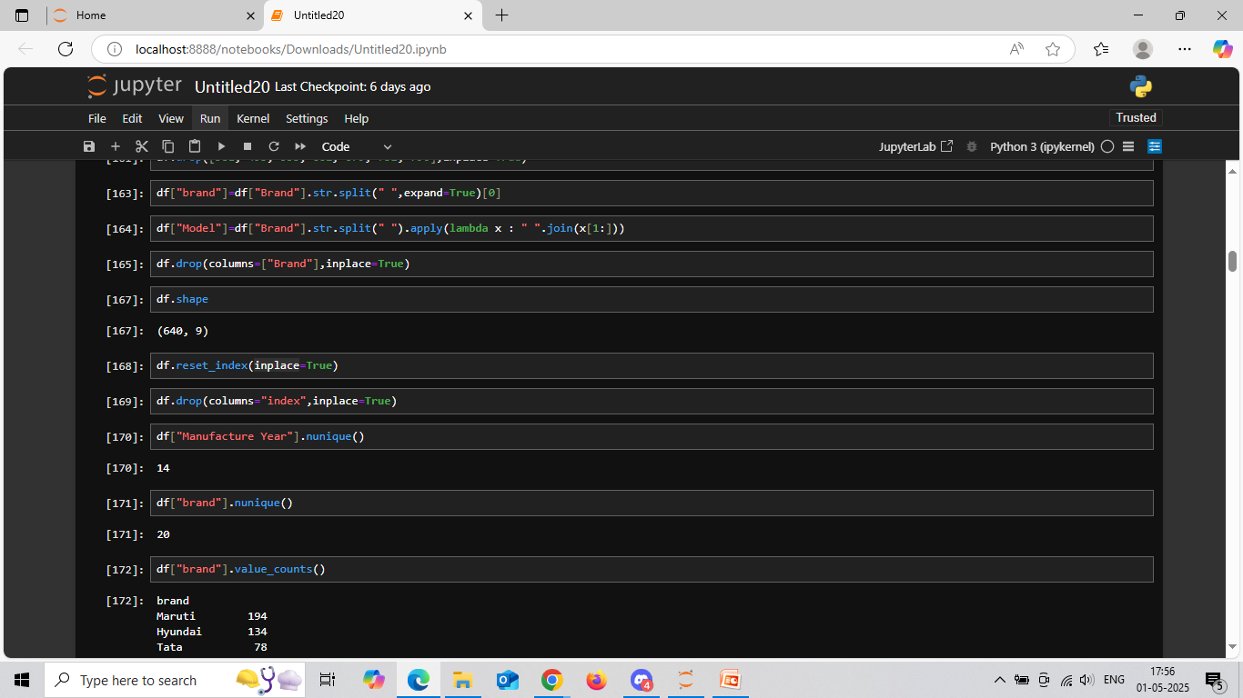
Data Cleaning:
Finding the car age using current year and maufacture year and creating a new column named “Car_Age”.
Splitting a single column which consist of brand and model into two separate columns named “Brand” and “Model”.

Slide 14
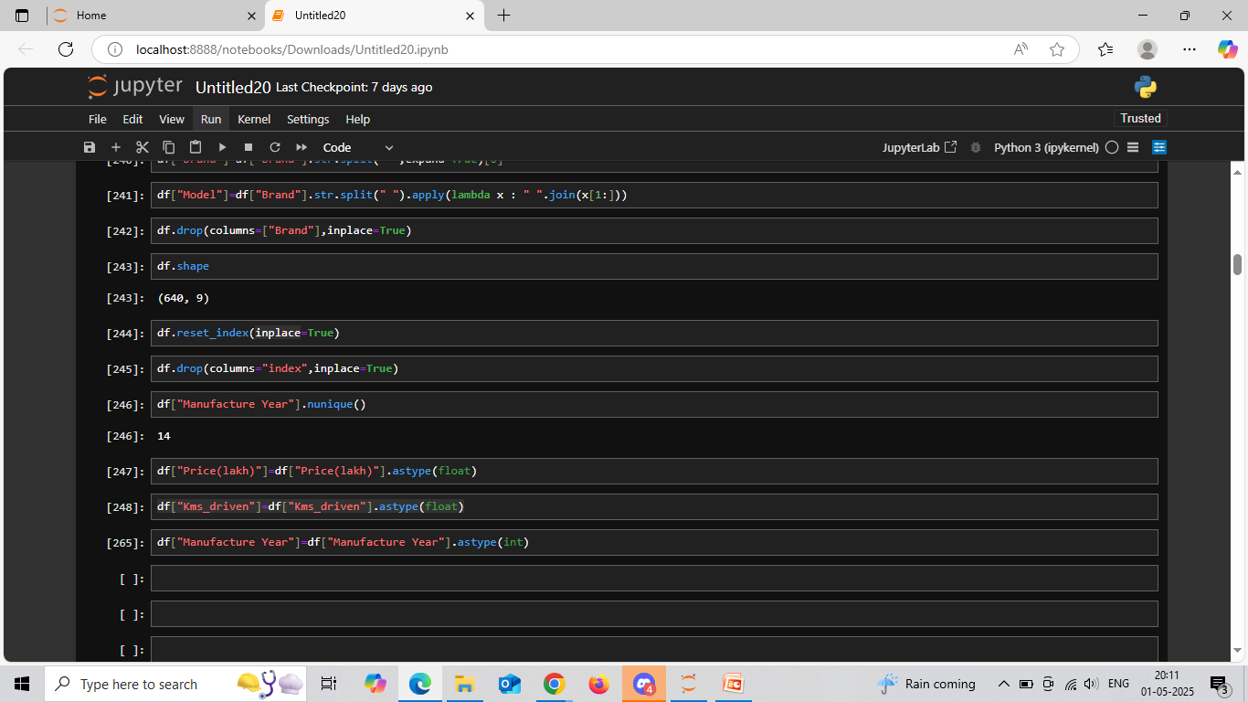
Data Cleaning:
Converting the data types of Price, Kms_driven and Manufacture_Year columns.
. Resetting the index.

Slide 15
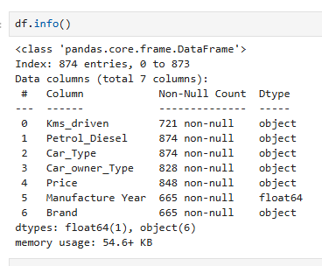
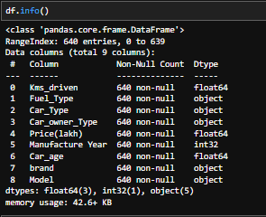
Data After Cleaning
Final data after cleaning where I left with 640 rows and 8 Columns.

Slide 16
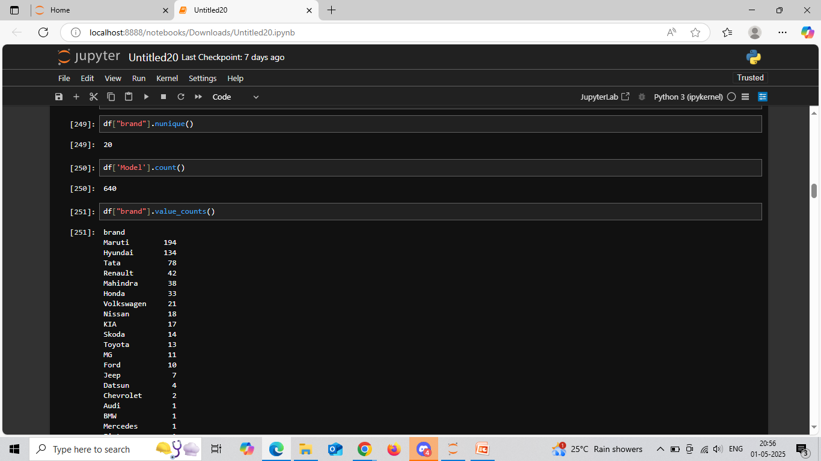
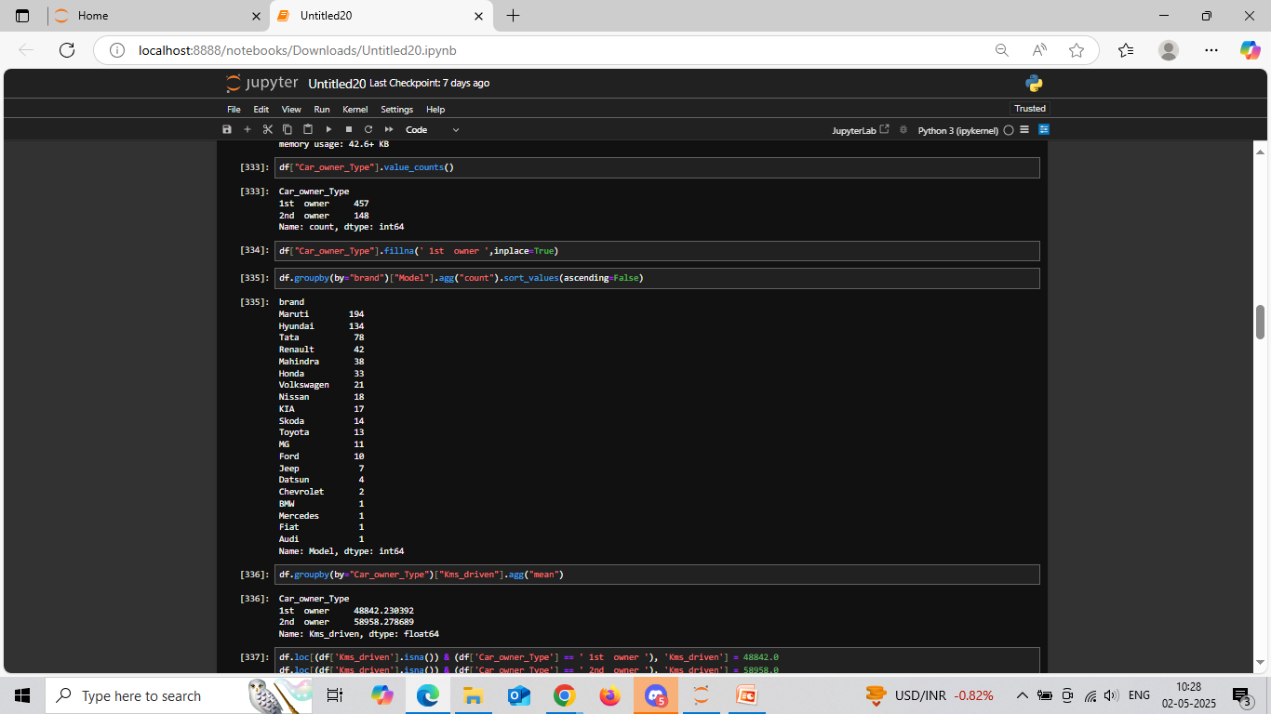
Count of Brands and Models in the Dataset
20 different brands are present in our dataset.
640 models from the brands are present in our dataset.

Slide 17
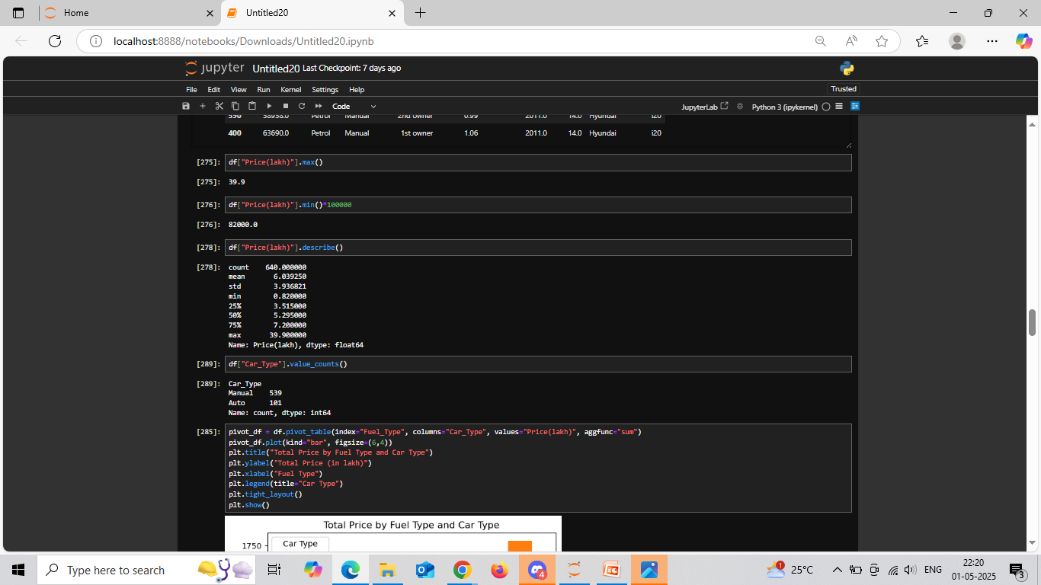
Price Range of Cars in the dataset
Maximum price of the car is 39 lakhs.
Minimum price of the car is 82 thousand.
Average price of the cars are around 6 lakhs.

Slide 18
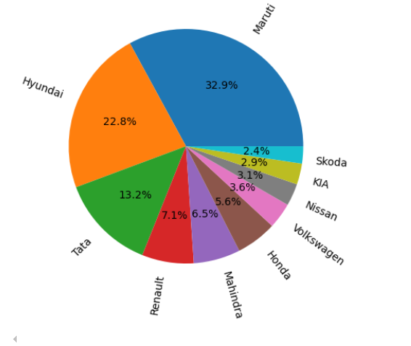
Top 10 Brands Percentage distribution
Major Cars:
32.9% cars are from Maruti.
22.8% cars are from Hyundai.
13.2% cars are from Tata.
Minor Cars:
3.1% cars are from Nissan.
2.9% cars from KIA.
2.4% are from Skoda.

Slide 19
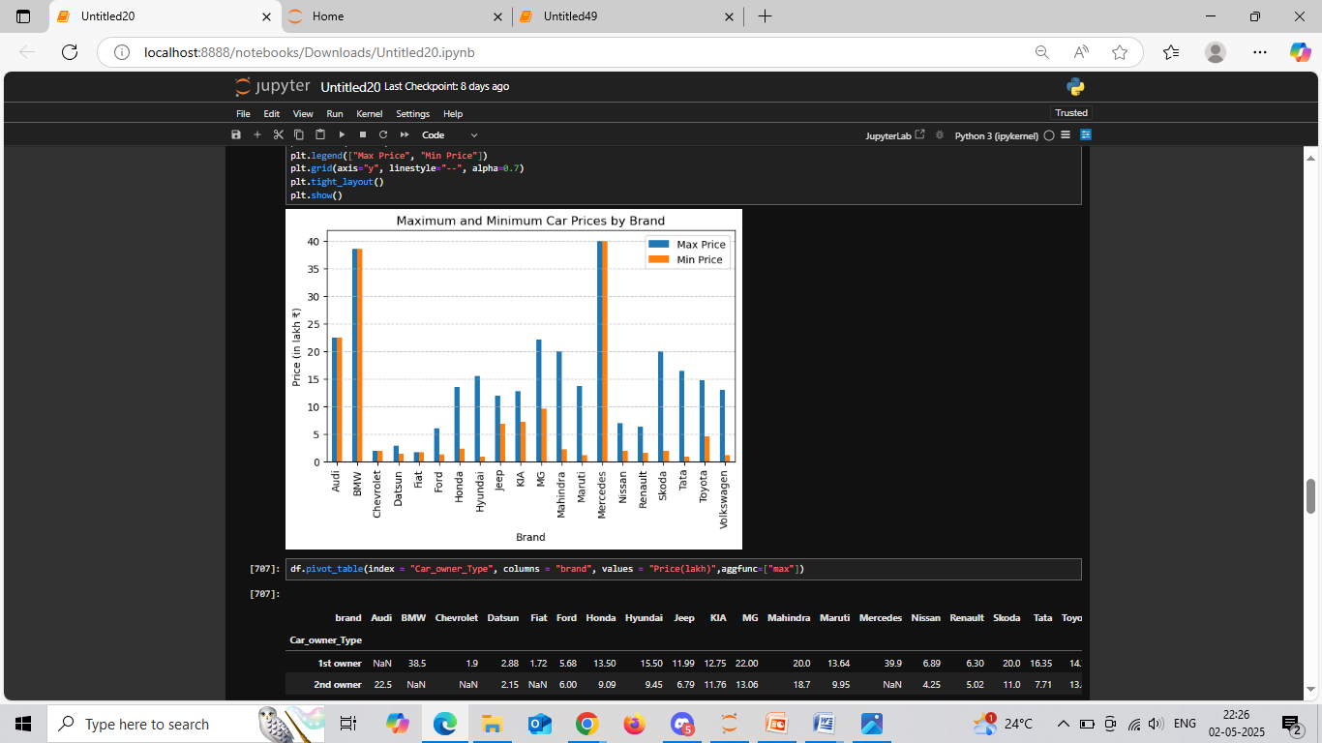
Maximum and Minimum Car prices by brand
Maximum priced cars are Mercedes,
Benz,Audi
Minimum priced cars are Maruti,Hyundai,
Tata

Slide 20
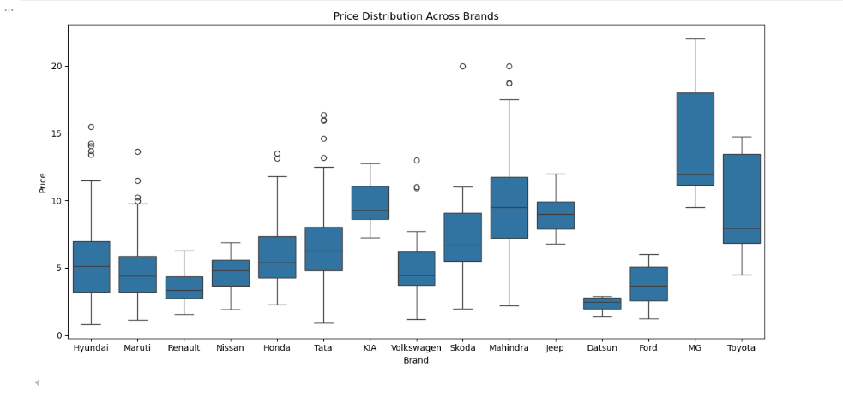
Price Distribution Across Brands
Hyundai, Maruti, Tata manufactures both budget and luxury models .
Mahindra mostly manufactures premium and high range cars.
MG manufactures only high range cars

Slide 21
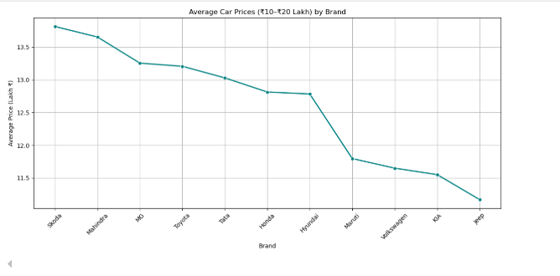
Average Car prices(10-20 lakhs) by brand
11 Brands falls in the average price range 10 to 20 lakhs

Slide 22
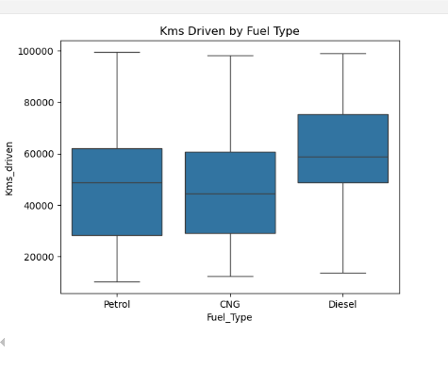
Kilometers Driven by Fuel Type
Graph shows that Diesel cars
gives more mileage than petrol,CNG Cars

Slide 23
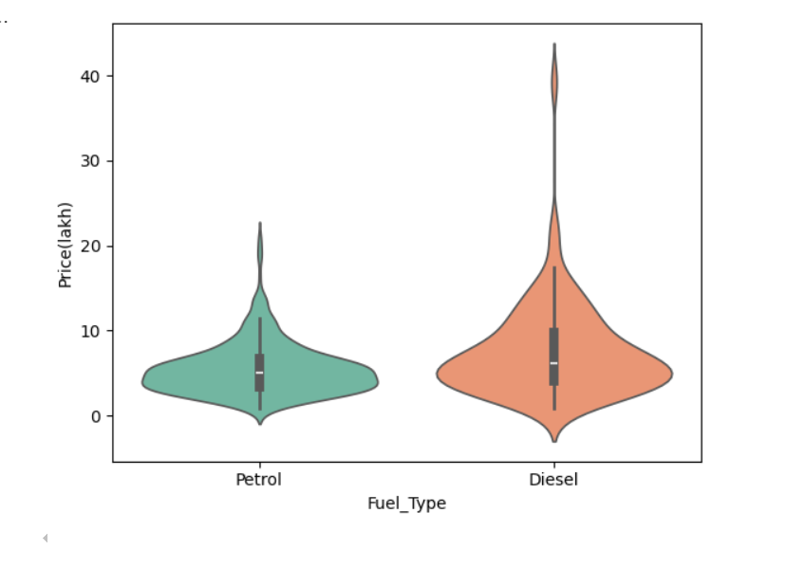
Price Variation Across Different Fuel Types
Most Petrol cars price falls in the
between 0 to 15.5 lakh .
Most Diesel cars price fall in the
between 0 to 25 lakh .
50% of petrol cars are around 7 lakh .
50% of diesel cars are around 8 lakh . .

Slide 24
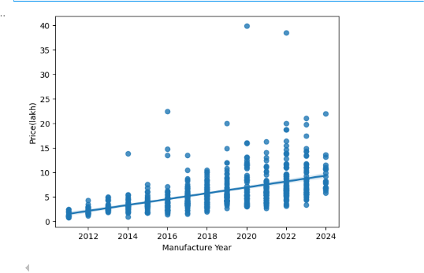
Impact of Manufacturing Year on Car Price
From this graph we can analyze that as the
increase in Manufacturing Year car price is
also increases

Slide 25
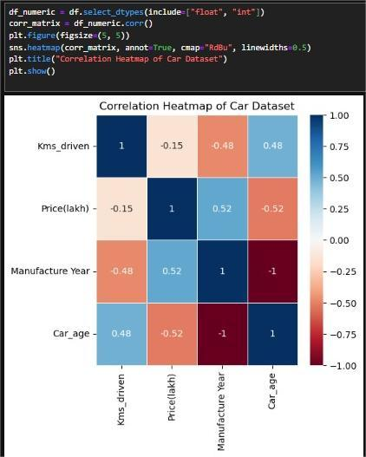
Correlation Heatmap of Car Dataset
. Negative relationship between
Price and Kms driven.
. Positive relationship between
Manufacturing Year and Price.

Slide 26
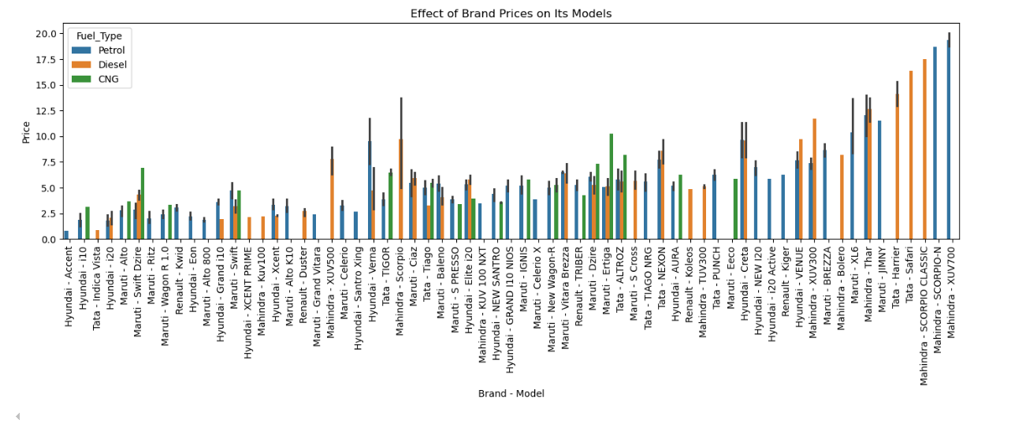
Effect of Brand Prices On Its Models

Slide 27
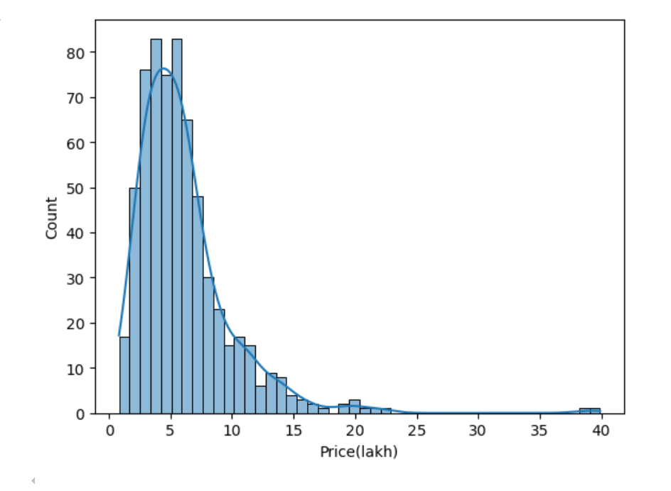
Price Range Analysis of Used Cars
There are more cars in price
between 2.5 lakhs to 6.5 lakhs

Slide 28
Observations
After detailed analysis of the project we got the following insights:
Price decreases significantly as the car get older
1st owner cars have high resale value than 2nd owner cars
Brands like BMW, Mercedes, Audi retain better value
Petrol cars are often cheaper than Diesel cars
Major price range of cars are between 2.5 to 6.5 lakhs
New model cars are of high price
Diesel cars gives more mileage

Slide 29
Conclusion:
Car price is most influenced by age,mileage,brand,fuel type
High brand cars are of high price and have high resale value
There are less CNG cars available in the market
Major budget cars are from Maruti,Hyundai
Diesel cars are of high price range compare to petrol cars

Slide 30

THANK YOU

